Slide 1





Introduction to Oracle
Oracle Database XE, APEX and Oracle SQL Developer
Oracle
SoftUni Team
Technical Trainers
Software University
http://softuni.bg

Slide 2

Oracle Database
Overview

Slide 3
What is Oracle Database?
Oracle Database
World's leader in enterprise database systems
Powers big organizations, e.g. the financial sector
Designed for very large databases (exabytes of data)
Supports everything from the DB world
Transactions, stored procedures, big data, cloud, …
Very expensive, for big players only
Has a free version (Expression Edition – XE)

Slide 4
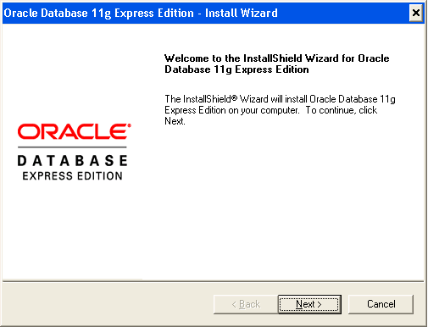
Oracle Database Express Edition (XE)
Oracle Database Express Edition (XE)
Free, limited version
1 CPU, 1 GB RAM, 11 GB storage
Installing Oracle Database XE
Download Oracle Database XE for Windows or Linux
Install it in a folder without spaces, e.g. C:\Progra~1\Oracle
Remember the admin password (for the users SYS and SYSTEM)

Slide 5
Oracle Database XE Services and Ports
Oracle XE services
OracleServiceXE
The Oracle database engine for the "XE" instance (SID)
The core of the Oracle database engine
OracleXETNSListener
Connects Oracle database with client applications (TNS service)
Listens on TCP port 1521 (TNS listener)
Holds the "Application Express" Web interface (APEX)
Listens on TCP port 8080 – http://localhost:8080

Slide 6
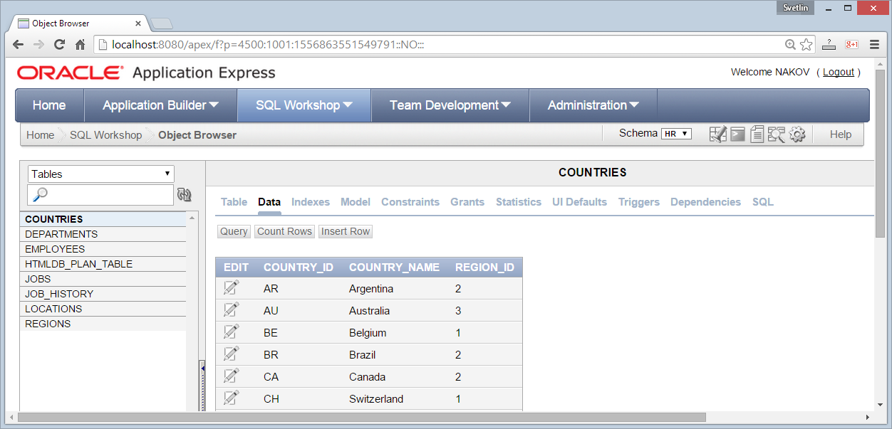
Oracle Application Express (APEX)
Oracle Application Express (APEX) – http://localhost:8080/apex
Design, develop and deploy database-driven Web applications
Web-based tool for SQL developers & administrators

Slide 7
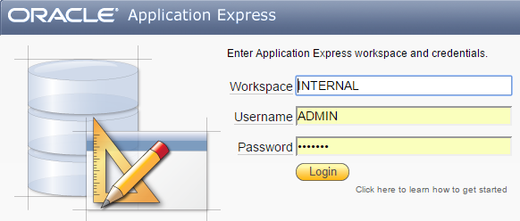
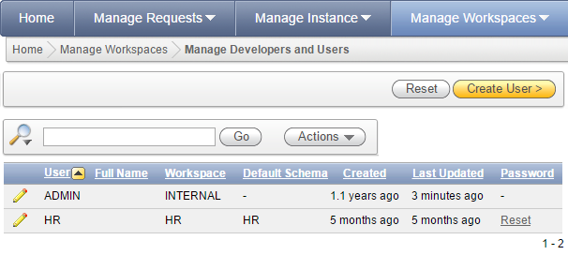
Oracle Application Express (APEX) – Admin
Login as admin in Oracle Application Express (APEX)
Create workspaces
Manage workspace users

Slide 8
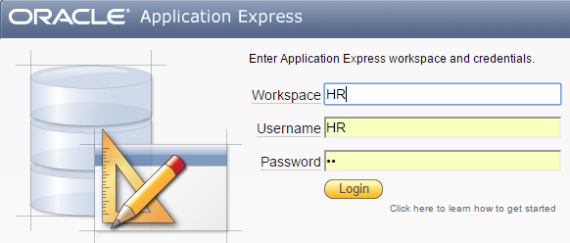
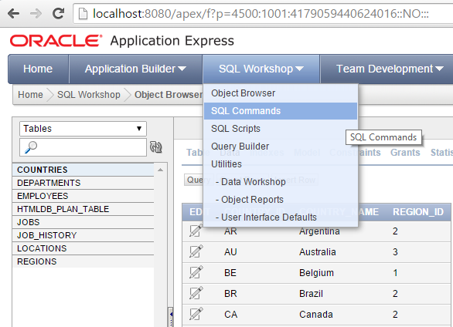
Oracle Application Express (APEX) – SQL
Login as user "HR" in Oracle Application Express (APEX)
Manage database objects
Run SQL commands
Build SQL queries

Slide 9
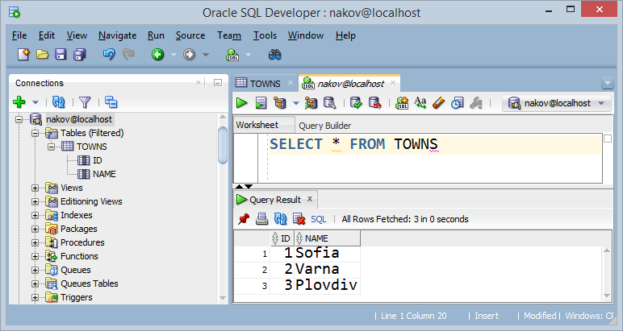
Oracle SQL Developer
Oracle SQL Developer is database GUI client tool for managing Oracle databases: SQL queries, manage DB schema, code, debug, …

Slide 10
Users SYS and SYSTEM in Oracle
User SYS
Holds the system schema SYS and data dictionary (DB metadata)
Has a DBA role
Contains most database system privileges, e.g. "create user"
Has a SYSDBA privilege – can start / stop / create / recover DB
User SYSTEM
Has a DBA role – can administer the DB, e.g. create users
No SYSDBA privilege

Slide 11
Creating a New User in Oracle
Oracle provides single database with multiple users
MS SQL Server and MySQL have many databases
"User (schema) in Oracle" == "Database" in MSSQL and MySQL
Creating a new user (schema) and give typical privileges:
CREATE USER maria IDENTIFIED BY "p@ssw0rd123" DEFAULT TABLESPACE "USERS";
GRANT CREATE SESSION, CREATE TABLE, CREATE VIEW, CREATE PROCEDURE, CREATE SEQUENCE, CREATE TRIGGER, UNLIMITED TABLESPACE TO maria;

Slide 12
User Privileges and Roles in Oracle
Users in Oracle may have certain privileges
CREATE SESSION – allows the users to connect to DB
CREATE TABLE / CREATE VIEW / CREATE PROCEDURE / …
UNLIMITED TABLESPACE – unlimited storage quota
SYSDBA – unrestricted DB access
Users in Oracle may have certain roles
DBA – database administrator (can add / edit / delete users, assign roles an privileges, edit all table data and edit all DB objects)

Slide 13
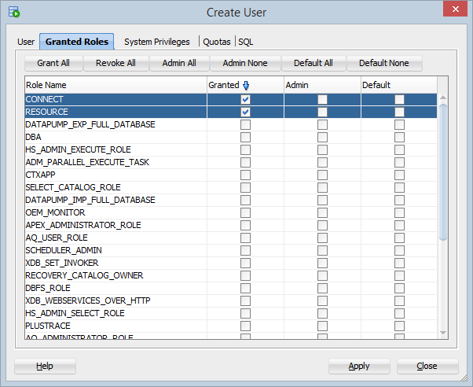
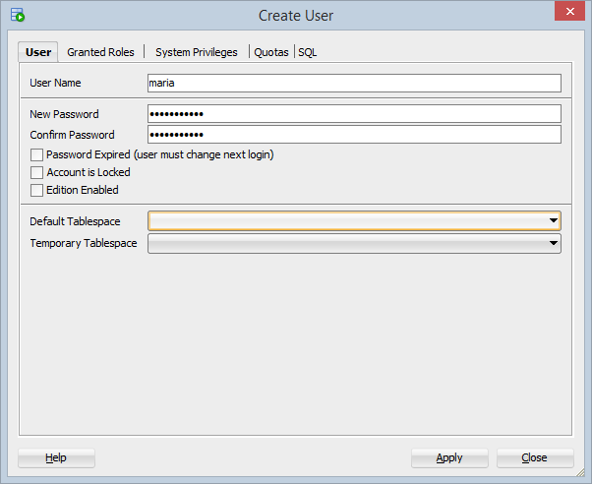
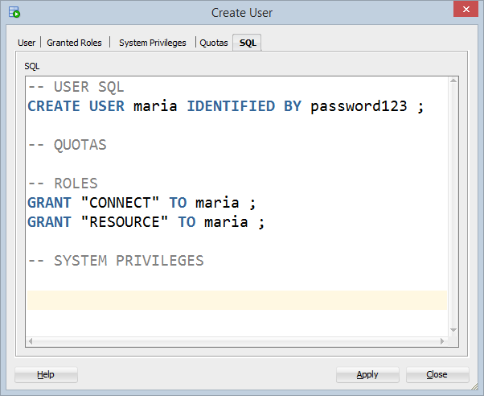
Creating a New User in SQL Developer

Slide 14
Oracle Data Types
NUMBER(precision, scale) – a number, e.g. 12345
precision – total number of digits
scale – number of digits to the right of the decimal point
VARCHAR2(length) – sequence of characters (up to 4000)
NVARCHAR2(length) – sequence of Unicode characters
DATE – date and time, e.g. "18-June-2015 20:30:07"
BLOB – binary large object (e.g. PDF document or JPEG image)
CLOB – character large object (e.g. HTML document)

Slide 15
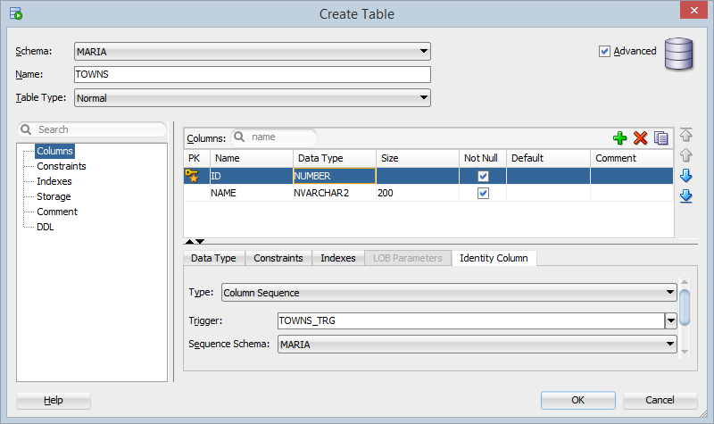
Creating Tables in SQL Developer

Slide 16
Beware: Oracle has Specifics!
Oracle database has some specifics
One database with many users (schemas)
Each user has its own schema (tables and other DB objects)
Use UPPERCASE for all identifiers
Otherwise you should use the quoted syntax, e.g. "My Table"
No auto-increment columns (until version 12c)
Use a SEQUENCE + TRIGGER for auto-increment
In Oracle NULL is the same like "" (empty string)
This causes many problems!

Slide 17
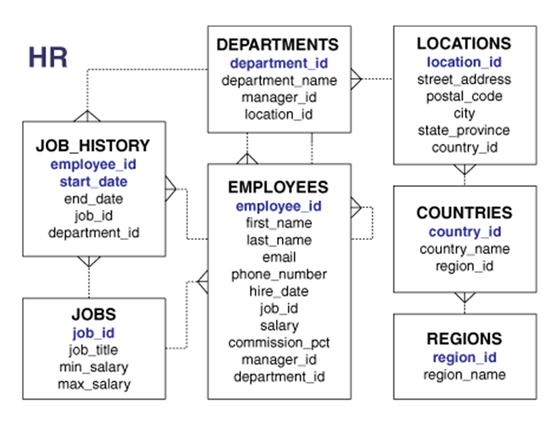
The HR Sample Schema
In Oracle, we have the "HR" schema, coming as sample database
The "HR" schema holds:
Employees
Jobs
Departments
Locations (addresses)
Countries
To use it, unlock the "HR" user and change its password

Slide 18
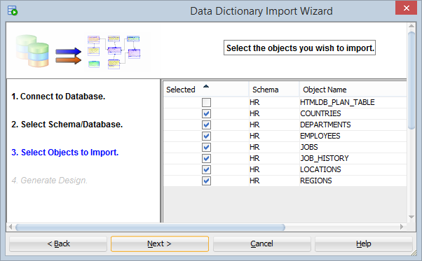
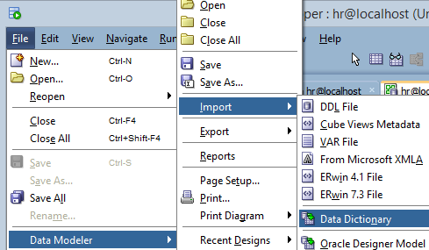
Creating Database Diagrams
Oracle SQL Developer supports database E/R diagrams
Use the Data Modeler tool to reverse engineer a DB schema

Slide 19
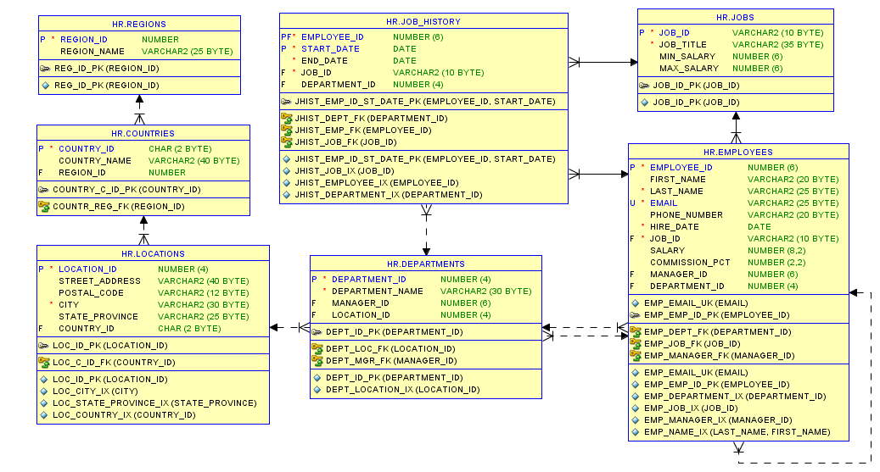
HR Schema – E/R Diagram

Slide 20


Summary
What is Oracle DB famous with?
Does it have a free version?
What is Oracle APEX?
What is Oracle SQL Developer?
How do we create a new user in Oracle?
Do you know some Oracle specifics?
How do we create DB diagram from existing database in Oracle SQL Developer?
Databases

Slide 21







Introduction to Oracle
https://softuni.bg/courses/databases

Slide 22
License
This course (slides, examples, demos, videos, homework, etc.) is licensed under the "Creative Commons Attribution-NonCommercial-ShareAlike 4.0 International" license
Attribution: this work may contain portions from
"Databases" course by Telerik Academy under CC-BY-NC-SA license

Slide 23





Free Trainings @ Software University
Software University Foundation – softuni.org
Software University – High-Quality Education, Profession and Job for Software Developers
softuni.bg
Software University @ Facebook
facebook.com/SoftwareUniversity
Software University @ YouTube
youtube.com/SoftwareUniversity
Software University Forums – forum.softuni.bg

